Slide 1
Health Monitoring and Disease Prediction using Deep learning Model

Slide 2
Group Member Information
Sahithi Thulluru (700752037)
Sahil Naidu Pagadala (700748694)
Pavan Uppala (700754009)
Priyanka Nayudu (700756568)

Slide 3
Role/Responsibilities and Contribution in project
Description/Task | Responsibility - Person
Data Read and Preprocessing | Sahithi Thulluru & Sahil Naidu Pagadala
Model Selection (simple feedforward Neural Network) | Sahil Naidu Pagadala & Pavan Uppala
Implementation(Data Splitting, Neural Network Training & Evaluation, Hyper parameter Tuning, K-fold cross validation, Decision Tree) | Sahithi Thulluru, Sahil Naidu Pagadala, Pavan Uppala & Priyanka Nayudu
Result Analysis | Priyanka Nayudu & Pavan Uppala

Slide 4
Motivation
Improving Healthcare Decision-making: Enhancing medical facilities to ensure better patient diagnosis and treatment decisions.
Utilizing Deep Learning: Harnessing the power of deep learning to process large and complex medical information.
Early Disease Prediction: Implementing disease prediction for early prevention, aligning with the adage "Prevention is better than cure."

Slide 5
Objectives
Utilize deep learning to analyze both structured and unstructured healthcare data, aiming to accurately assess disease risk with unprecedented accuracy and depth.
Implement latent factor model approach within neural network architecture to address challenges posed by missing data in structured healthcare records, enhancing completeness and reliability of analyses.
Employ deep learning techniques to automatically identify features from unstructured text data, enriching analyses and providing a more comprehensive understanding of underlying health dynamics.

Slide 6
Related work
Disease Phenol Type Similarity: Exploring miRNA prediction for human diseases using network-based techniques.
Extreme Learning Machine for Multilayer Perceptron: The paper provides empirical evidence of the effectiveness of ELMs for training MLPs across various datasets, highlighting their potential as a powerful tool for machine learning tasks.
Heart Disease Prediction: Utilizing Naive Bayesian classification and data mining tools for accurate risk factor prediction in heart disease.

Slide 7
Problem Statement
Traditional healthcare predictive analytics methods struggle to accurately forecast diseases from patient treatment histories and health data, prompting a need for more advanced approaches.
Deep learning neural networks offer a revolutionary solution to this challenge, leveraging their ability to learn complex patterns directly from raw medical data.
Integrating deep learning into healthcare aims to enhance patient care by enabling earlier disease detection, personalized treatment approaches, and improved treatment efficacy, ultimately leading to better outcomes.

Slide 8
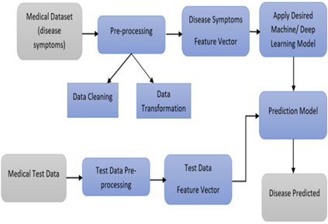
Proposed Solution
Adoption of latent factor model within neural network architecture to address missing data.
Utilization of deep learning techniques, such as the neural network (simple feedforward Neural Network) algorithm, for feature extraction from text data.
A test function is then utilized to predict diseases based on user-provided symptoms, converting them into a binary input vector for inference through the trained neural network.

Slide 9
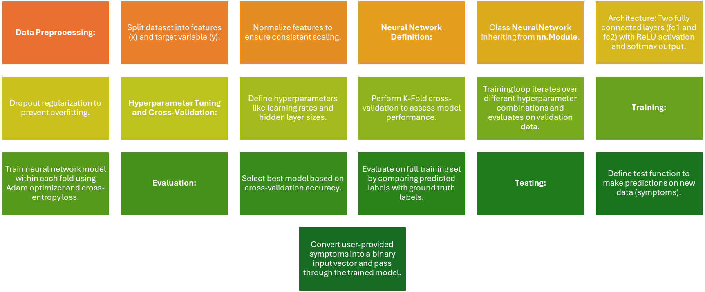
Neural Network Implementation

Slide 10

Result Analysis
Accurate model evaluation requires careful separation of data into training and testing sets, with a common practice of allocating 67% for training and 33% for testing. This ensures that the model's performance is assessed on unseen data, crucial for gauging its real-world effectiveness.
Monitoring the distribution of samples and labels in both the training and testing sets provides valuable insights into the representativeness of the data partitions. Maintaining a balanced distribution is essential for robust model assessment and generalization, facilitating accurate predictions on new, unseen data.
PyTorch facilitates the creation of a robust neural network model for categorization tasks, with meticulous data preparation including label encoding and feature normalization.
Leveraging two fully connected layers with ReLU activation and a softmax output layer, coupled with Adam optimizer and cross-entropy loss, the model achieves a commendable 90% accuracy on the training set, showcasing its efficacy in predicting target variables accurately.

Slide 11
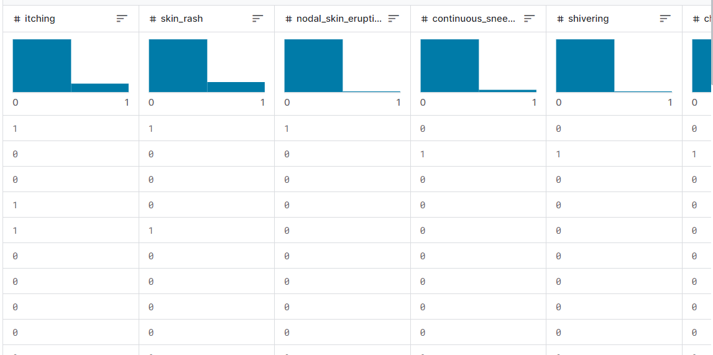
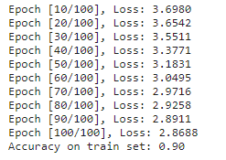
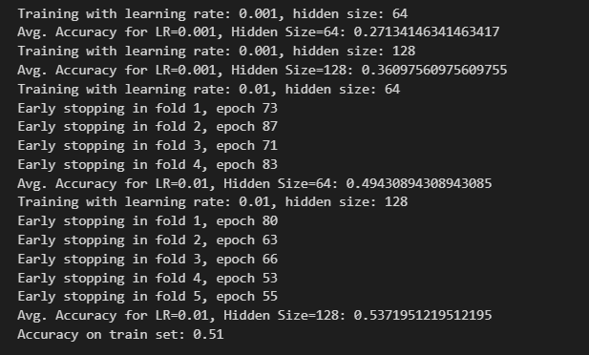
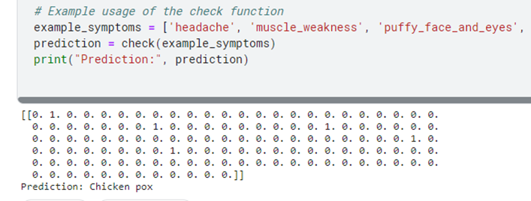
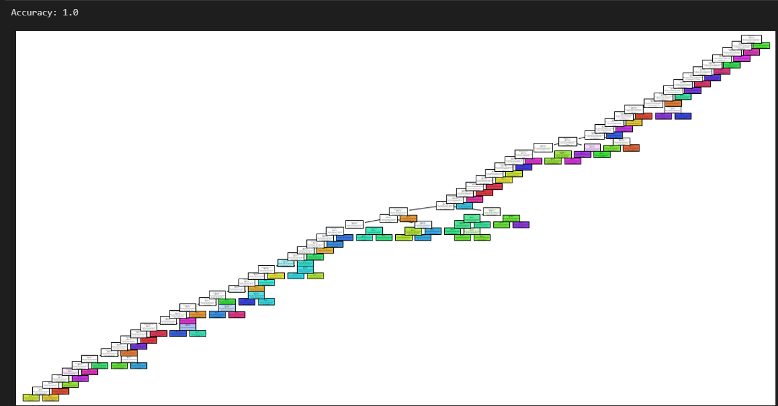
Result
Simple feedforward Neural Network
Data Sample
Sample Count
Hyper parameter tuning - K-fold
With Input Symptoms:
Decision Tree (Reference for comparison)

Slide 12
References
Kwon, K., Kim, D. & Park, H. A parallel MR imaging method using multilayer perceptron. Med. Phys. 44, 6209–6224 (2017).
2015 2nd National Foundation for Science and Technology Development Conference on Information and Computer Science" Duc-Hau Le, "Disease phenotypic similarity improves the prediction of novel disease associated microRNAs
Tang, J., Deng, C. & Huang, G. B. Extreme learning machine for multilayer perceptron. IEEE Trans. Neural Netw. Learn. Syst. 27, 809–821 (2016).
Anjan Nikhil Repaka, "Design and Implementing Heart Disease Prediction Using Naives Bayesian," in Proceedings of the Third International Conference on Trends in Electronics and Informatics (ICOEI 2019); IEEE Xplore Part Number: CFP19J32-ART; ISBN: 978-1-5386-9439-8

